Slide 1

CA22123 EU-MACE:
Core Group monthly update GP3 #2
Virtual
10/12/2025

Slide 2
meeting Agenda
Today’ meeting is recorded!

Slide 3
0. Key updates
GP3
  Work & BUDGET plan
  Important events
  Call for priority conferences for GP3
  Young EU-MACE/
  ERASMUS+ discussion meeting
EU-Consultation
Springer-Nature journal special edition – or not
AOB

Slide 4
latest news

Slide 5
Most recent events
Sustainable materials research project building (Task: Sustainability, leader: G. Campana) - followup
COST Action EU-MACE together with EERA (European Energy Research Alliance) joint programmes; AMPEA and E3S conduct project (proposal) building action within HEU 2026-2027 WP
Research topics on: Energy materials and processes or Energy technologies with mandatory inclusion of sustainability assurance (including safety, economic, environmental and social impact).
Over 50 expressions of interests received – of which 5 coordinator candidates
ChainMap ‘knowledge graph’ produced
Joint brokerage event (Hybrid) organized on October 20th
  70 ppl attended (5 in-person attendees of EU-MACE/EERA members)
  Coordinator presented their project ideas
  Discussion and exchanges with interested participants
Follow up meeting with coordinator candidates: November 26th with the coordinator candidates
  At least 3 coordinator candidates have been in ‘direct’ discussion with potential partners
Sustainable materials & device design workshop – planned for Feb 23-24-25
  2 full days of in-person workshop (20-25 invitees from EU-MACE)
  Combined with ½ day MC meeting (online)

Slide 6
Most recent events
Legacy2MAP: MCSA DN proposal (Task: Legay Labs, leaders – Ozlem, Sandra) SUBMITTED on Nov 25!!
Human-machine collaboration for transforming existing Legacy labs into automated, autonomous and inter-operable Materials Acceleration Platforms empowering energy materials research ecosystem
3 WPs directly from Legacy Labs collaborations
  High entropy alloys
  MOFs
  Nanofluids
1 cross-cutting WP on
  Cloud-connected workflow
  DeepSearch TDM
  Sustainability (sustainable prototype building)
  Social Science (human-machine interaction and impact on scientific research practices)
Preparing MCSA doctoral network proposal
  Beneficiaries: IST (PT), BAM (DE), AIT (AT), THR (DE), UTH (GR), UStrath (UK), USFD (UK), CEA (FR), UNL (PT), GEM (IT),
  Associated: VTT (FL), NCBJ (PL), UniTO (IT) Aixelo (US), VimiLab (DE)
Let’s keep the momentum and create MORE Legacy-Lab projects/partnerships

Slide 7
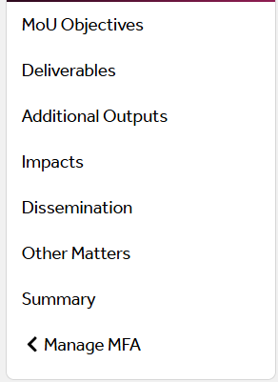
PR2 report
Reporting elements:
Report filled in by AC
Approved by MC members
File uploaded on « filesender » link shared on Slack
Submitted in mid-November

Slide 8
TDM-update
Update given by K. Malek
Whitepaper is advancing, but experienced some delay
Draft written by Th. Karakasidis (MC, GR) and now being edited by K. Malek (WG3 leader, DE)
Will be finalized in soon and be presented in January/Feb 2026

Slide 9

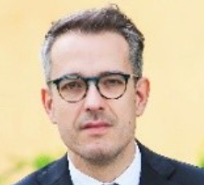

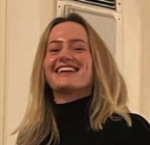
New Grant Holder Institute
GHI = European Energy Research Alliance
EERA: EU-MACE member from the start, WG5 - Dissemination & Comm’s leader (Ms. Gloria Botton)
GH SR = Dr. Ivan Matejak (MC member, Belgium) - Director SET Plan & Strategic Programming
GH M = Ms. Dorotea Koren
Scientific communication’s coordinator = Ms. Dorotea Koren replacing Ms. Gloria Botton
Ivan
Gloria
Dorotea

Slide 10
GP3 plans

Slide 11
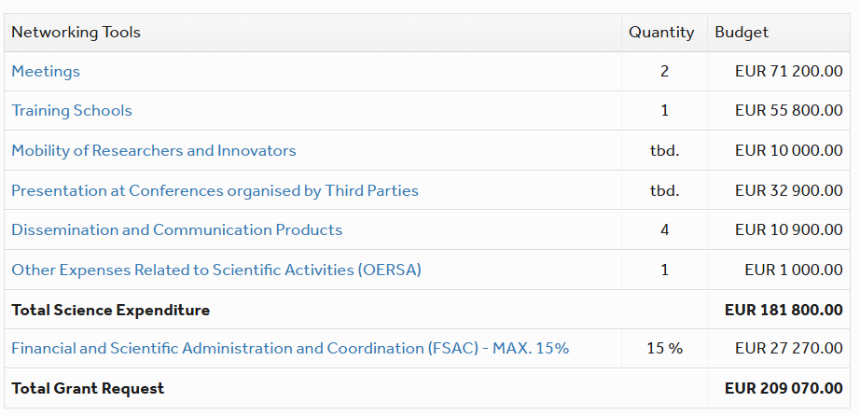
GP3 budget plan-under MC approval phase
1 MC/WS sustainability in Feb/March 20
1 WG/Task meeting (ERASMUS) Sept
AcceLMAPs, May 2026 in Portugal
STSM = 5!
20 total CG’s
Web maintenance
Finally a promotional video?
2 x Publication fee
Bank charges, shipping costs
MCs approval completed ➔ GA ready!! ➔ waiting for GHI signature ➔ Activities start!

Slide 12
WG & Task leader mandate
In MC1 meeting, we have decided to change WG/Task leaders (if needed) @M12 AND we must increase the participation of ICT, young & female members participation
WGs & Task | current | GP3
WG1 – perovskites | Dorottya Kriechbaumer(DE) | Dorottya Kriechbaumer(DE)
WG2 – metallic alloys | Jarek Jasinski (PL) | Jarek Jasinski (PL) – on going activity
WG3 – New materials | Kourosh Malek (DE) | Kourosh Malek (DE) – on going activity
WG4 - training | David Lacroix (FR) | Antonio P. Gonçalves
WG5/Communications | Gloria Botton (BE, YRI) | Dorotea Koren
Grant Award committee | Peter Tatarko (SR) | Peter continues!
Sustainability | G. Campana (IT) | Giampaolo Campana – just started new activity
Inter-COST Action actions | Norbert Babcsan | Continue? Plans? ➔ to be discussed at MC meeting
Young EU-MACE | Nobody so AC contacts | Ivy Tsang
Erasmus incubation | Theodora Kyratsi (CY) | Theodora Kyratsi (CY) NEED CG !!!
MAP & EXP List/database | Iosif Galanakis (GR) with K. Malek | Bogdan
Legacy Labs | O. Ozcan (DE) & Sandra Rabaca | Ivy Tsang ? & ONE MORE PERSON!
Industrial relations? | Holger Ihssen (DE) | Plans need to be discussed at MC meeting
Notes:
Ozlem: legacy lab through dataflow. For automation it’s good to have less advanced

Slide 13
GP3 plans

Slide 14
Planned events
Joint workshop on sustainable energy materials: How to integrate SSdB in energy materials research?
EU-MACE & EERA-E3S (clean Energy tranSition for Sustainable Society) & AMPEA (Advanced Materials and Processes for Energy Applications)
Will gather
  SSdB experts: available tools and use-cases
  Materials & technology experts: examples on how they tackle this challenge
  Regulatory aspects: to be defined
  Round-table/small group discussions
To pave new research collaborations!
In Brussels, Maison IFJC. February 23-25 with ½ day MC meeting (hybrid) before the workshop
Invite ~25 EU-MACE members (speakers and sustainability task participants from HEU brokerage events)
Include in discussion- HORIZON-CL5-2026-04-Two-Stage-D3-02 Next generation of renewable energy technologies
More detail to be announced in early January. BUT PLEASE SAVE THE DATE!!

Slide 15
Planned events
AcceLMAPs training school:
4 full days in Lisbon
Dates: May (exact days to be specified by the coordinator = A. P. Gonçalves)

Slide 16
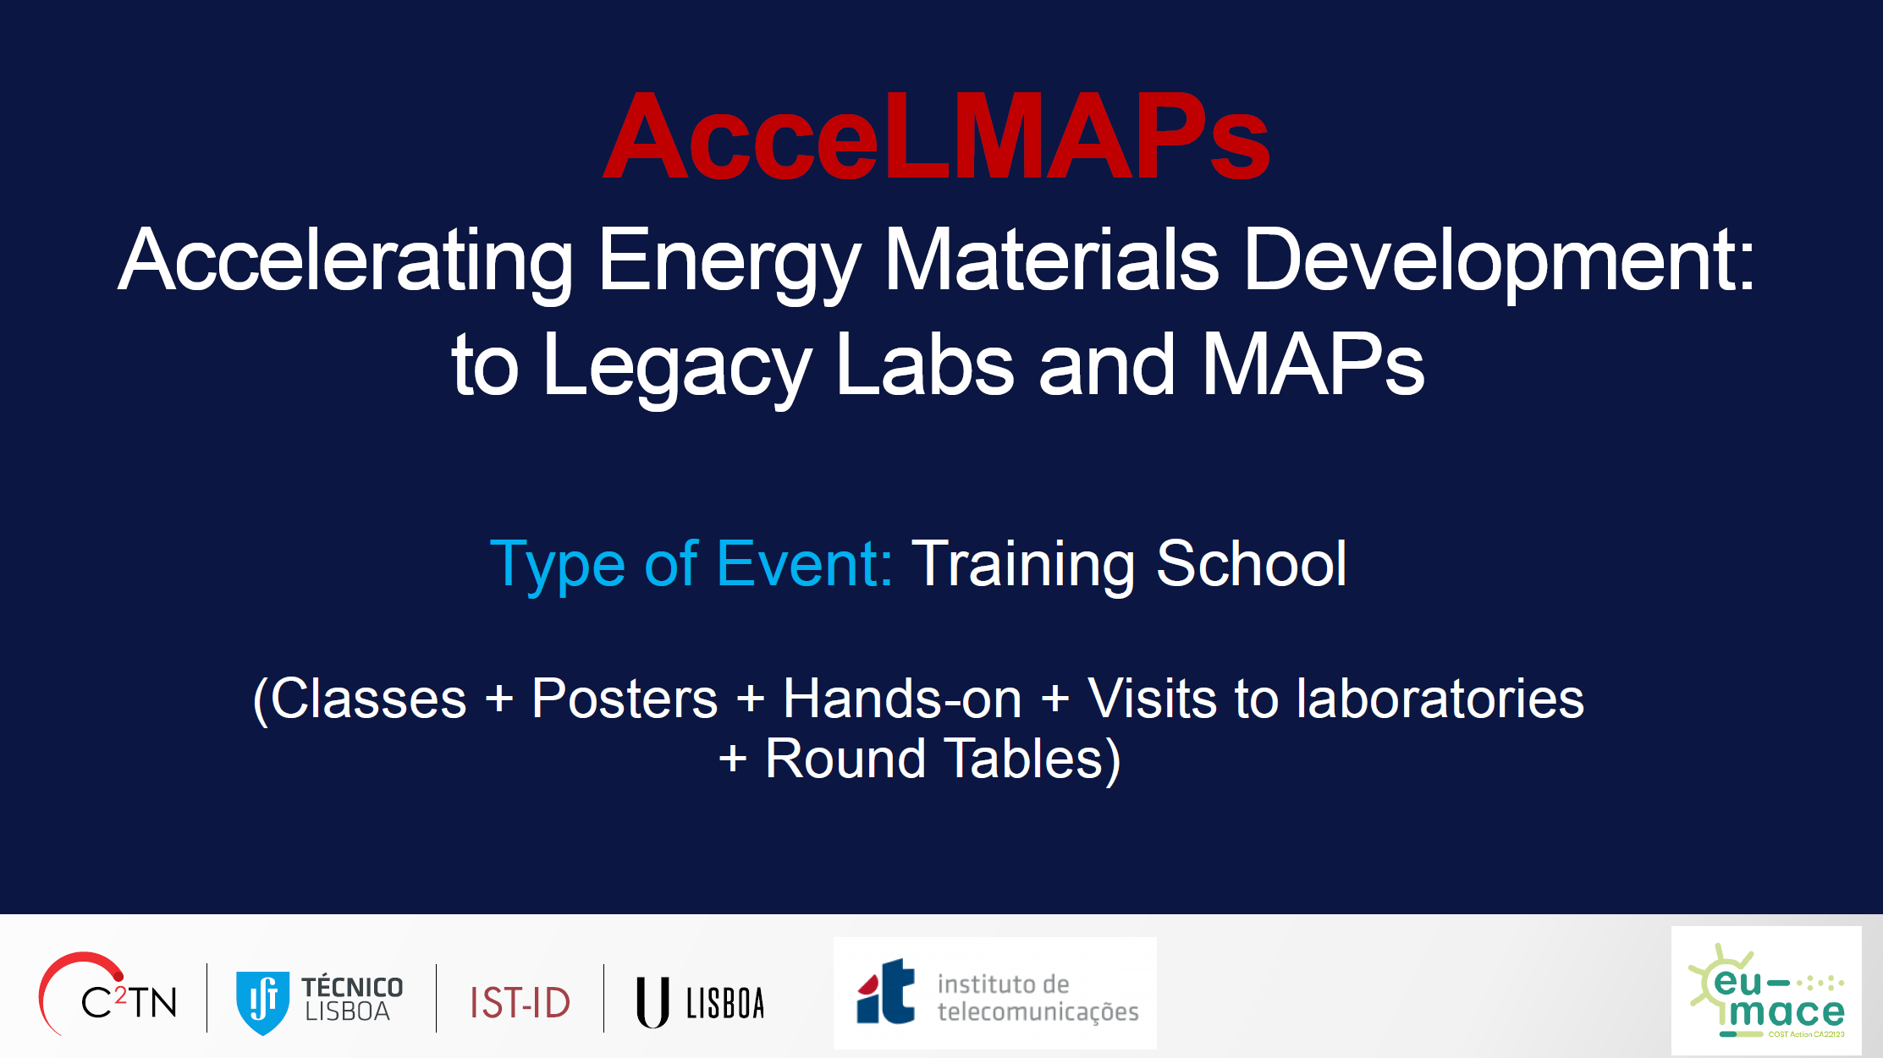

Slide 17
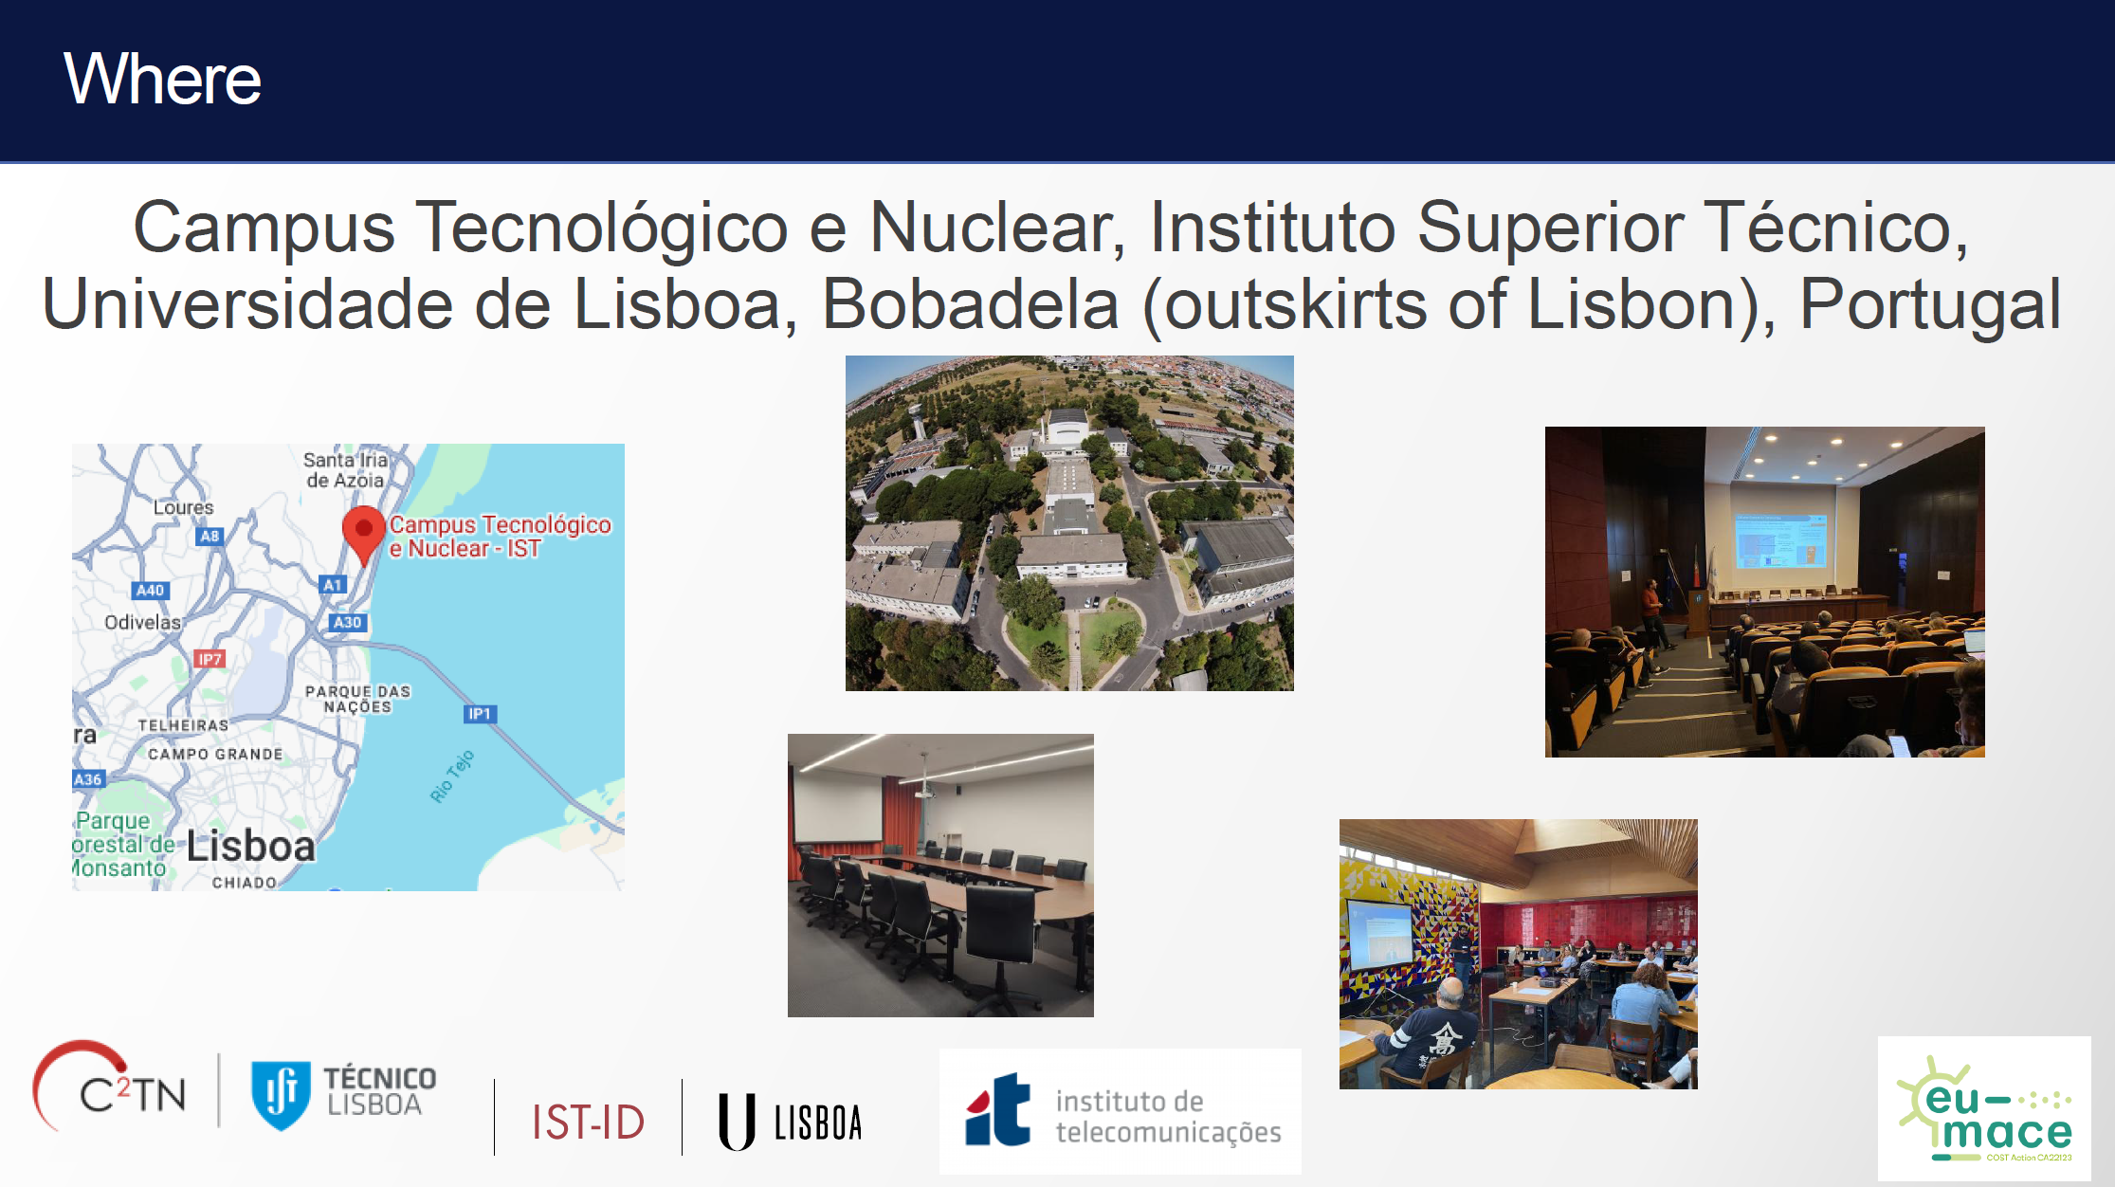

Slide 18
AceeLMAPs Training school
Lisboa, May 18-21, 2026

Slide 19
Totemic Session Planning
R | Monday 18 | Tuesday 19 | Wednesday 20 | Thursday 21 | Friday 22
Morning 1 | Arrival/Welcome | Ole Martin Løvvik | Elena Stefanaki | Maximilian Wolf
Morning 2 | Macieji Haranazyk | Ole Martin Løvvik | Nuno/Vicky | Maximilian Wolf
Afternoon 1 | Posters/Pitch | Kevin Rossi | Özlem Ozcan | Kourosh
Afternoon 2 | Labs visit | Patrícia/José | Stefan Maak | Open Discussions

Slide 20
Session titles
Monday May, 18 – Morning
Welcome
Macieji Haranazyk; “Introduction to materials discovery and MAPs”
Monday May, 18 – Afternoon
Posters/Pitch
Labs visit
  Tuesday May, 19 – Morning
Ole Martin Løvvik; “Accelerated discovery of functional materials at the atomistic scale”
  Tuesday May, 19 – Afternoon
Kevin Rossi; “Digitalizing materials science: from data and theory to forward and inverse models”
Patrícia/José; “Generative Diffusion Models for Inverse Discovery of Functional Materials”
  Wednesday May, 20 – Morning
  Elena Stefanaki; “The Thermoelectric Journey: Bridging Innovation and Application from Advanced TE Materials to Scalable Devices”
  Nuno/Vicky; “AI for ion beam characterization of energy materials”
  Wednesday May, 20 – Afternoon
  Özlem; “MAPs: Digital Workflows for Accelerated Material Discovery and Deployment”, Hands on?
  Stefan Maak; TBA

Slide 21
Session titles
Thursday May, 21 – Morning
Maximilian Wolf; “From Manual Lab Workflow to Self-Driving Experimentation: A Hands-On Transition Exercise”
  Thursday May, 21 – Afternoon
Kourosh; “Cloud connected labs for energy materials-to-device integration: from digital discovery to physical intelligence”
Open Discussions
  Wrap-up meeting

Slide 22
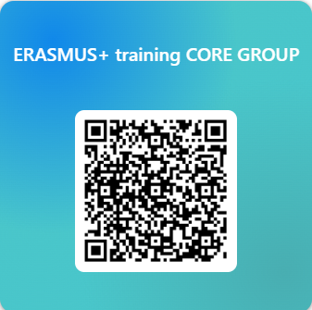
Planned events
ERASMUS+ discussion meeting (WG4): leader = Th. Kyratsi (CY) for now
ERASMUS+ or a similar network ➔ Action Deliverable and objective for GP4
Call for interests to be made for forming a task force
Online meetings starting in March 2026 to
  Compare existing course programmes of interested members
  Propose ‘new’ courses on automation and self-driving labs
  Select possible programme title/contents/members
In-person discussion meeting (2-days) in August/September/October 2026 in Warsaw (randomly chosen) ➔ TBD
  Final selection(s) of Universities/Schools
  Determine the consortium leader
  ……
https://forms.office.com/Pages/ResponsePage.aspx?id=9xZkbOgxIEWCTMuTP4OQuXsjyL-l515MkDTrXz9gtT5UMjVCNUNROVkyTlRKM0dHRTlFWDhRWVc2RS4u

Slide 23
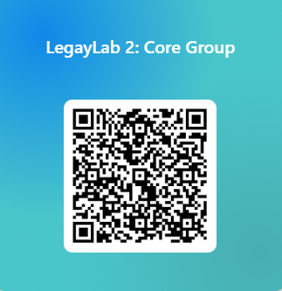
LegacyLAB 2
Starting LegacyLab 2nd round: who wants to join??
Create NEW collaborative research projects between Legacy labs & MAPs
  Expand your MAP capabilities
  Connect your legacy lab equipment to MAPs
  HEU projects, bi-lateral projects, doctoral networks….
STSM visits: 10 k€ (5-8 visits possible)
  Perform preliminary experiments
  Discuss future research plans
We need leaders and members!
https://forms.office.com/Pages/ResponsePage.aspx?id=9xZkbOgxIEWCTMuTP4OQuXsjyL-l515MkDTrXz9gtT5UQTlHQkRNT0FJODRBVlRTVUZHWllHVzNHVC4u
Let’s keep the momentum and create MORE Legacy-Lab projects/partnerships

Slide 24

Special issue publication opportunity!!
Proposition from SpringerNature DISCOVER SURFACES (it is a new journal series)
Special issue: Energy materials (Editor says ok)
Possible themes/titles
  "Surfaces and Interfaces in Energy Materials: How Interfaces Drive Energy Conversion, Storage, and Catalysis“
  "From Surface Chemistry to System Integration: Interfaces at the Heart of Energy Materials“
  "Interface Dynamics in Energy Materials: From Atomic-Scale Phenomena to Device Performance"
Divide into:
  WG1 – Perovskites
  WG2 – Alloys
  WG3- MOFs, SPEs (and zero-PFAS?)
  Include – research methodology
    MAPs for surface/interface optimization
    Data management of surface (formidable challenge)
Open Access
Free of Charge until November 30, 2026
Who wants to contribute, who can be a co-guest editor and who can review? https://forms.office.com/Pages/ResponsePage.aspx?id=9xZkbOgxIEWCTMuTP4OQuXsjyL-l515MkDTrXz9gtT5UNUhMOTRaUzFGTFRYOE81MFhGRUg4N1pENC4u
Only 7 people answered! Please do it now

Slide 25
Commission seeks feedback on the future Advanced Materials Act
https://research-and-innovation.ec.europa.eu/news/all-research-and-innovation-news/commission-seeks-feedback-future-advanced-materials-act-2025-10-21_en
EC seeking input from all interested stakeholders to the forthcoming Advanced Materials Act
To feed and shape HEU and FP calls on Advanced Materials
Many EU research entities are preparing/contributing
Should EU-MACE submit?

Slide 26
Next meetings + important message
Action monthly meeting: Tuesday January 13, 2026 @3PM
More and concrete details on Sustainability workshop & HEU call brokerage
Roadmap paper on LegacyLabs
MC members:
WG application/member issues – to be contacted separately prior to MC meeting
MAP & Expert list - ChainMap:
A separate meeting to be organized in early January (doodle): Iosif, Saco, Kourosh, Bogdan & anyone?

Slide 27
Thank you for your attention !!

Slide 28
B2B platform for MAP & Expert list
EU-MACE B2B ecosystem intelligence platform now online: link under ‘tools’ menu of our home page
Created by Kourosh Malek (FZJ)
Maintenance team
  Gloria Botton (comm., EERA, BE) ➔ to be replaced by new comm’s coordinator
  Iosif Galanakis (MC, Greece)
  Sawako Nakamae AC
  Monica Fabrizio VC
Currently available
  Material expertise database
  HEU project interest database
To be developed
  MAP and infrastructre ➔ need help!!
  Conversion to true B2B ➔ need help!!
  Involve other COST Actions ➔ contacted

